Slide 1


Today is
Safer Internet Day
2025!

Slide 2
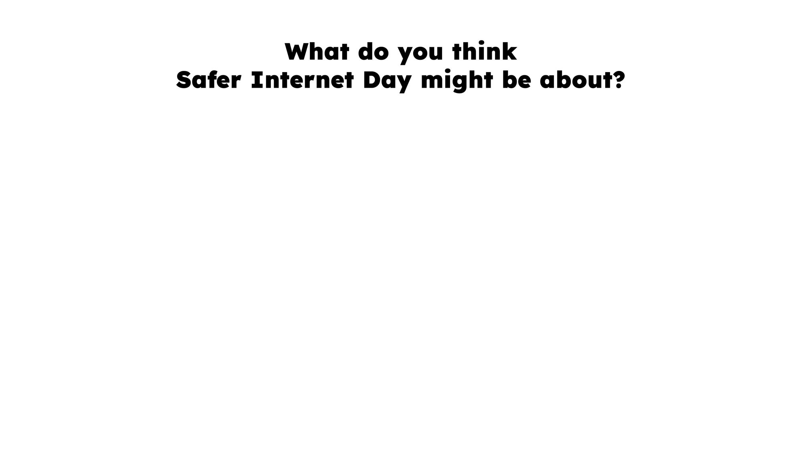

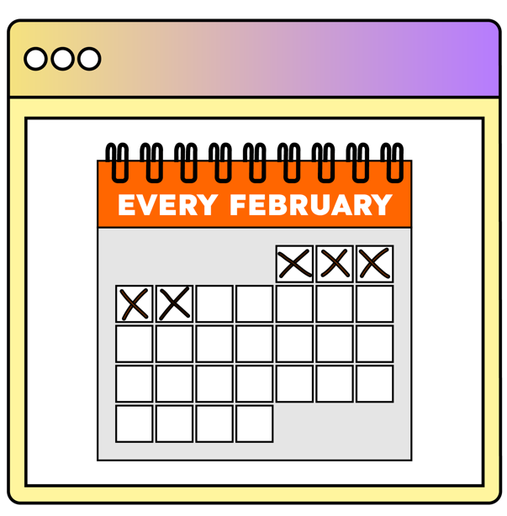
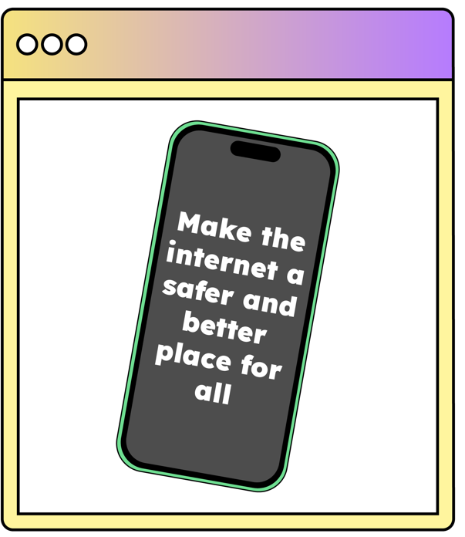

Safer Internet Day is held every February all around the world.
It’s a chance to think about any worries we might have about using technology and the internet, but it’s also about celebrating all the fantastic things technology can help us with.

Slide 3


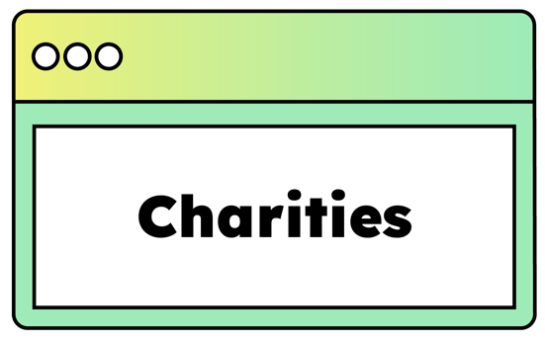





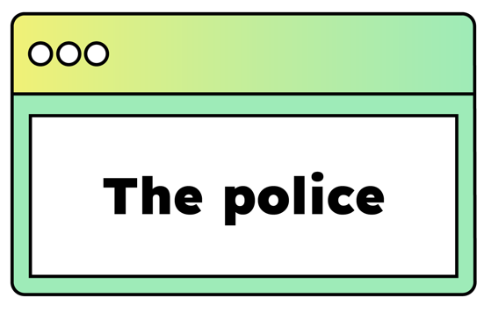
It’s not just schools who join in with the day,
lots of other people get involved too.
Notes:
!

Slide 4
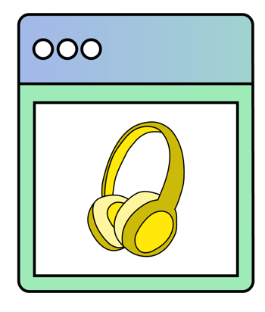





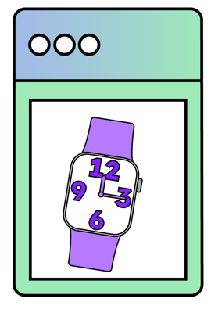
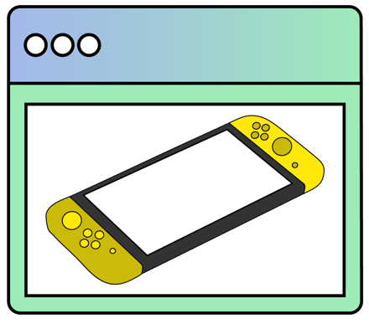
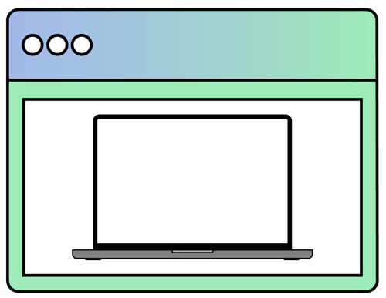

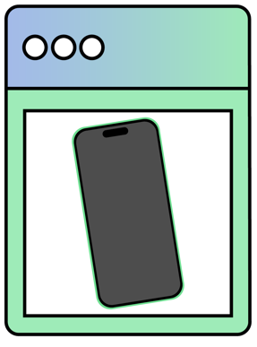

Slide 5
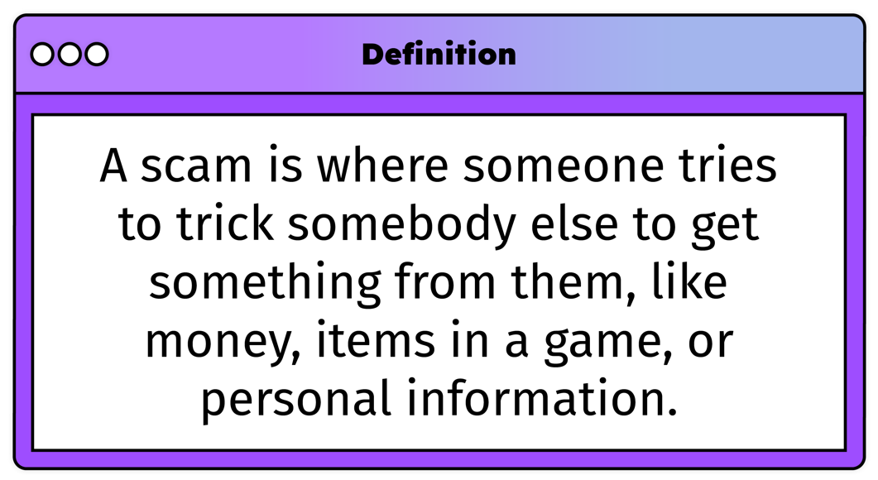
This year on Safer Internet Day we are thinking about an important issue: online scams.
What is a scam?
It can be
online
Or it can be
offline

Slide 6
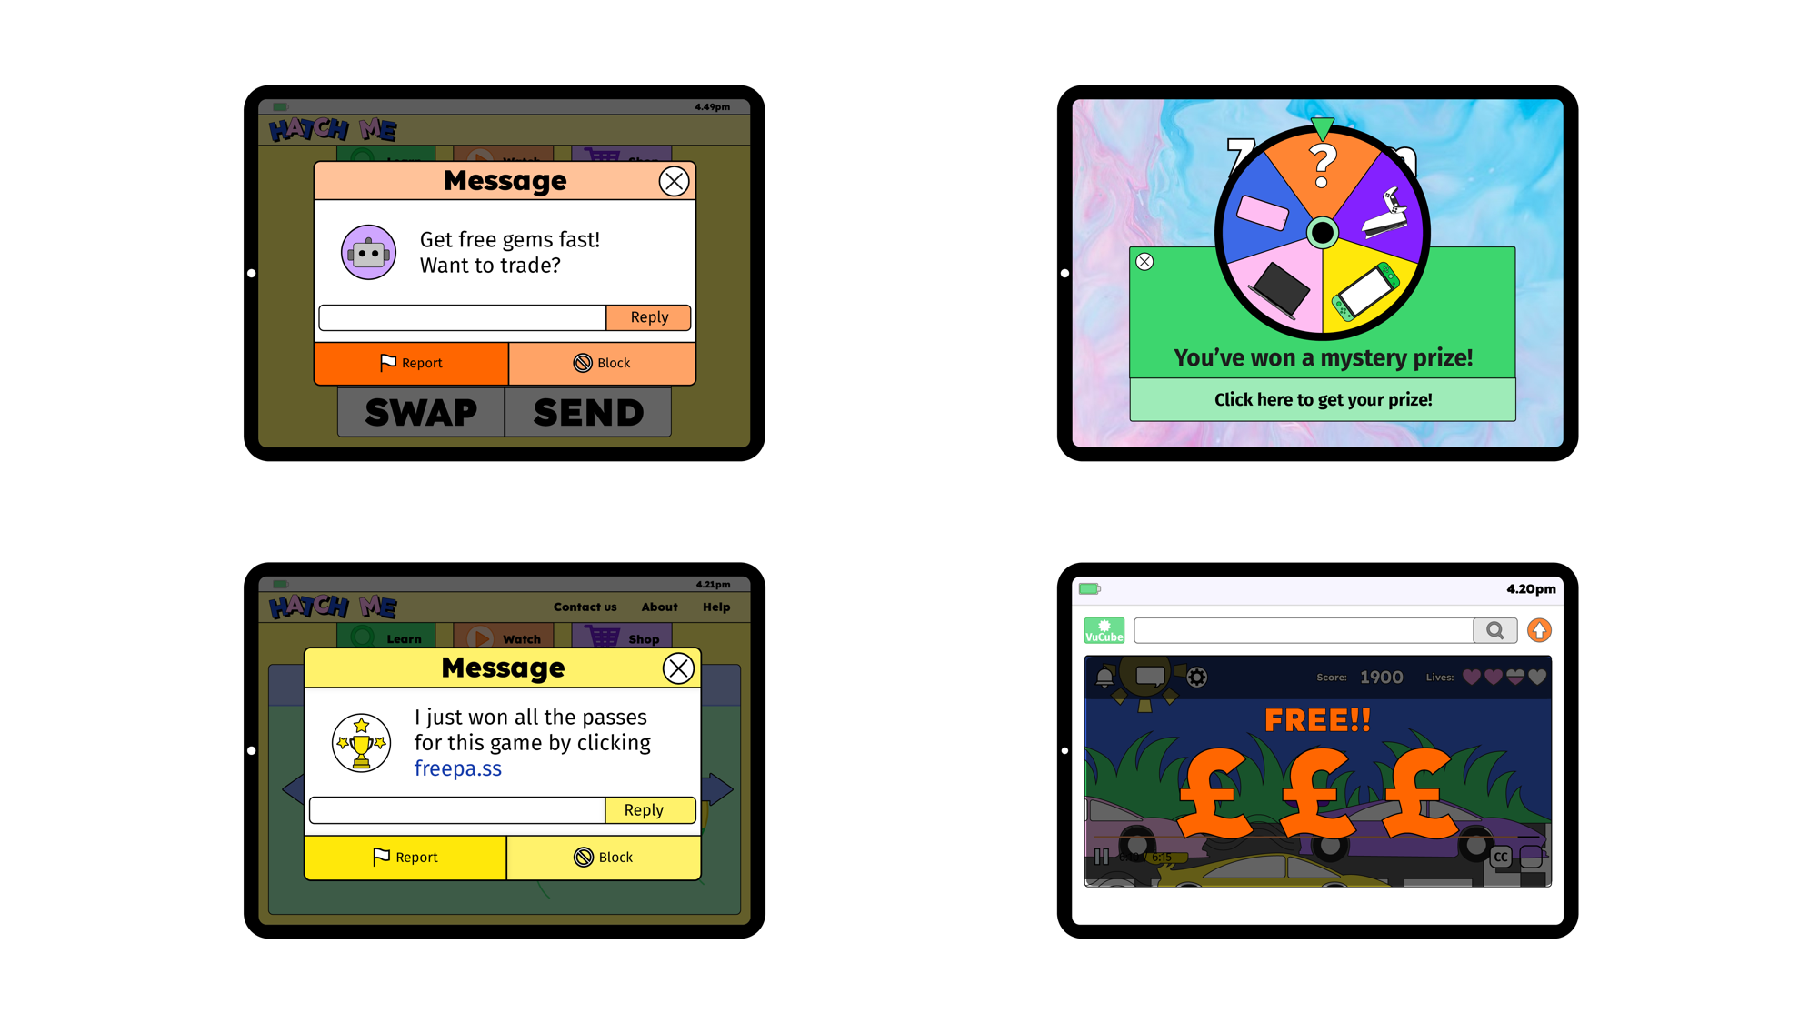


There are lots of types of scams online –have you seen any of these before?
A message pop up from somewhere unusual or with a strange link to click on?
Something that seems too good to be true – like you’ve won a prize!
A video or app pop up saying you can get free money!

Slide 7








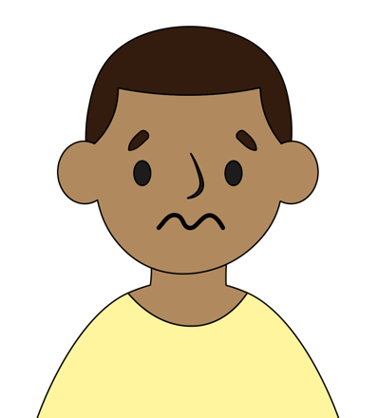
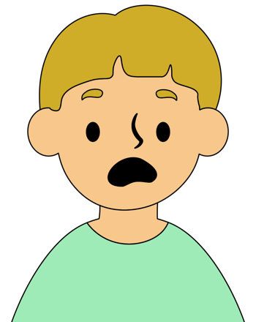

Seeing these things can make us feel different emotions. We might feel…

Slide 8

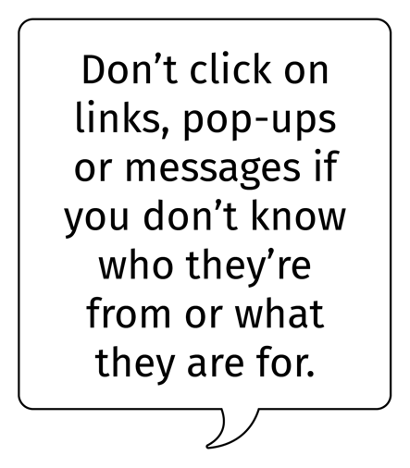
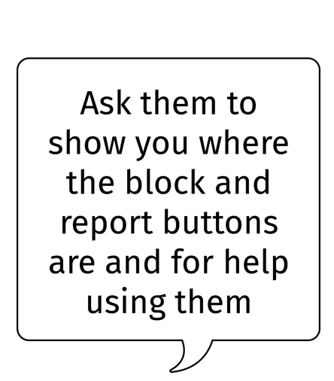
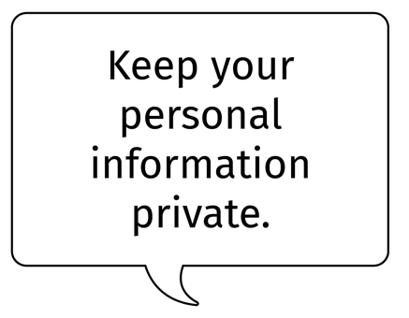
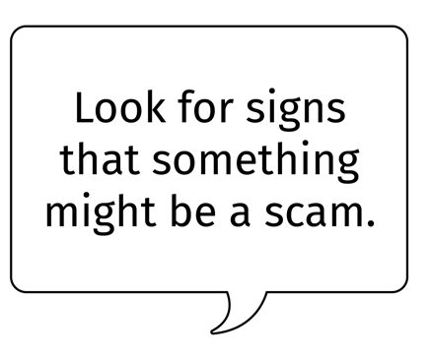
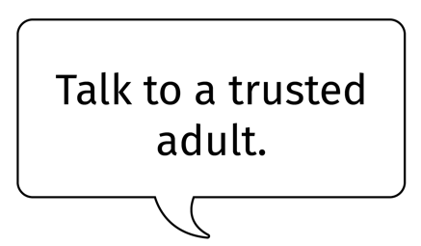


Slide 9







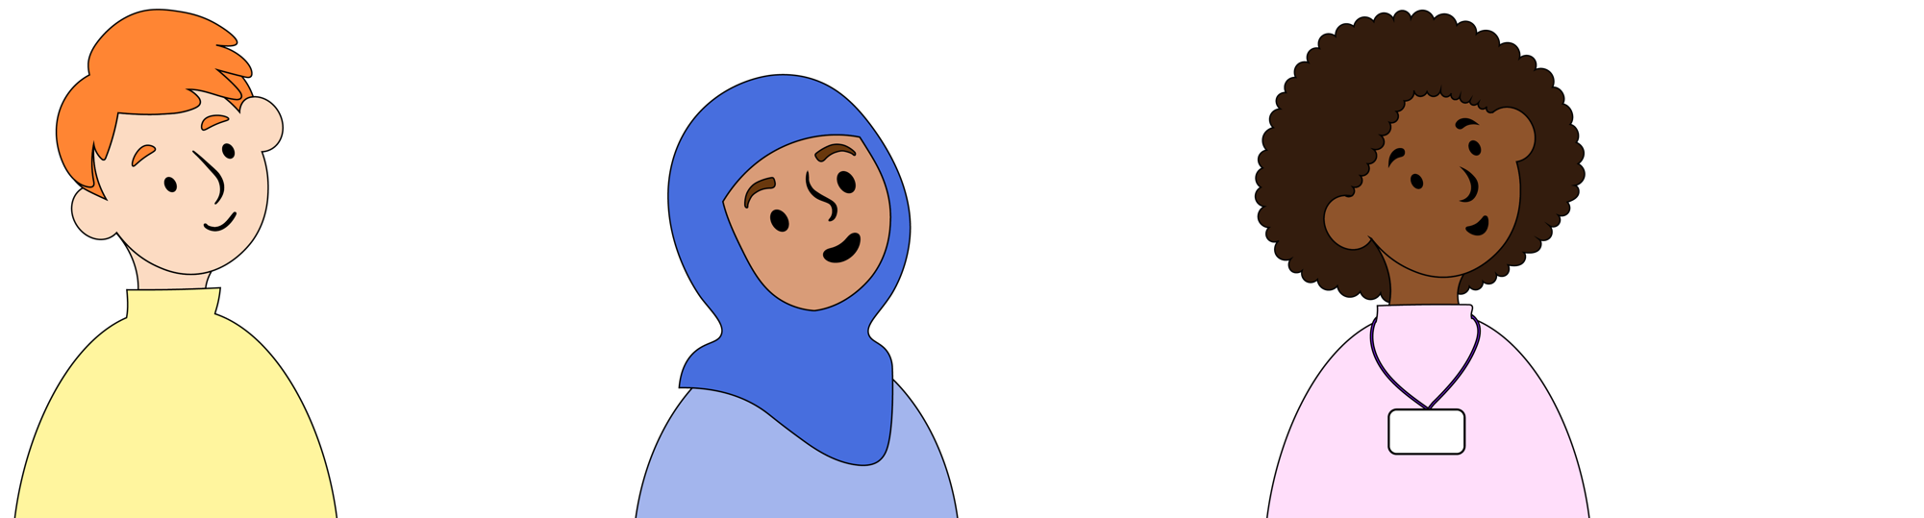


Slide 10


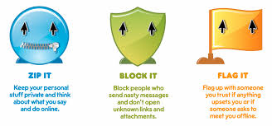
Don’t forget.
If you ever have a worry about something that’s happened online, remember our school online safety rule…

Slide 11


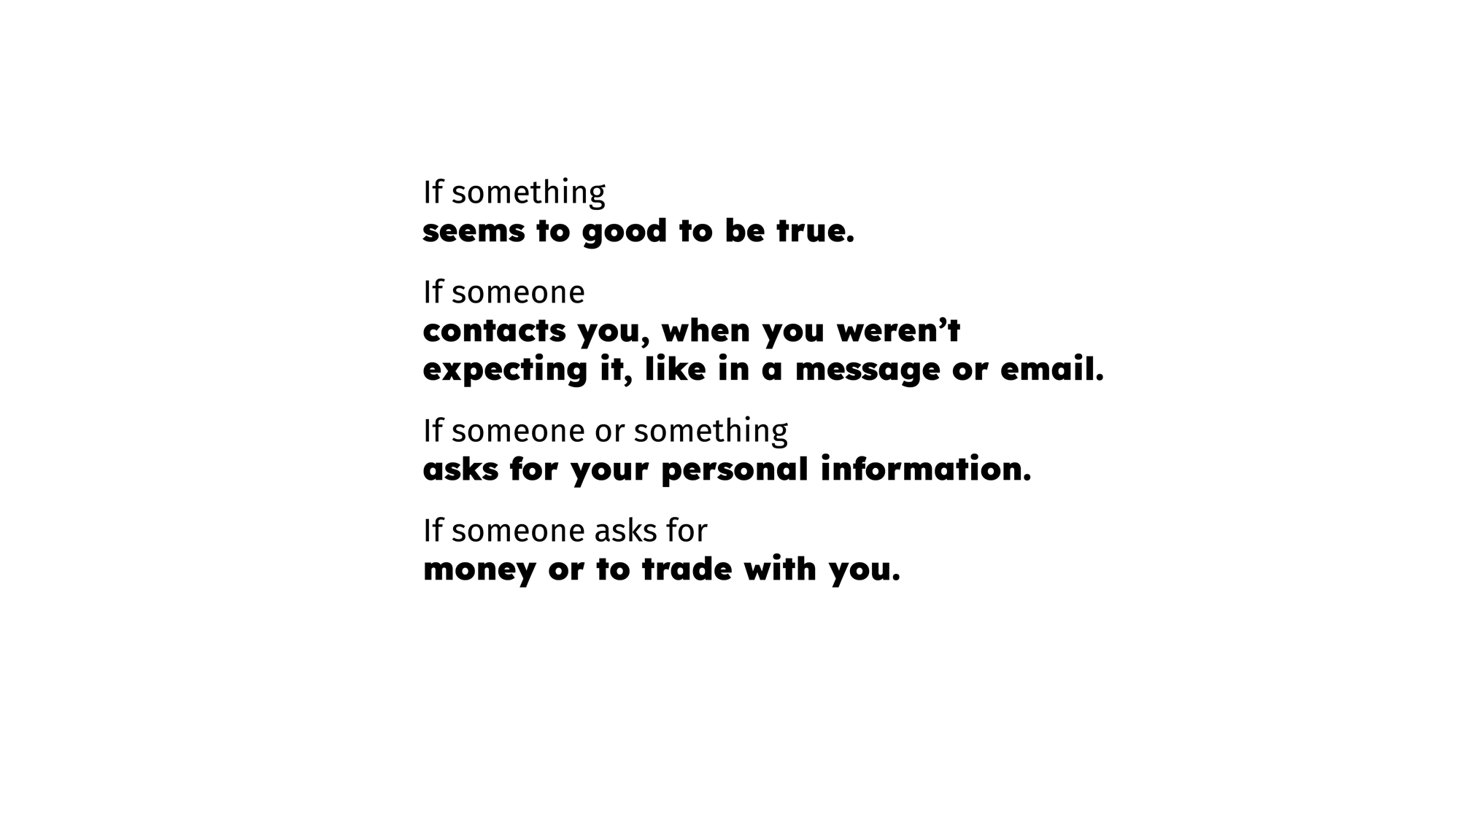

Let’s finish by looking at this clever way to spot the signs of a scam!

Slide 12
Happy
Safer Internet Day!

